Slide 1
ECMO Utilization in
“High-Risk” Populations
Zachary Rumlow DO
Pediatric Critical Care Fellow PGY-5
Susan B Meister CHEAR Fellow

Slide 2
Objectives
By the end of this talk attendees should understand:
The differential risk associated with ECMO utilization
Patient and hospital level factors that may be associated with ECMO utilization in “high-risk” patients

Slide 3
Who gets ECMO
Considerations for ECMO Utilization:
  Patients with high anticipated mortality with conventional therapies
  and
  Patients who would be more likely to receive benefit than harm from ECMO
  and
  Patients with a reversible/and or transplantable pathology
ASAIO J.: 2020 Indications for Pediatric Respiratory ECMO (Maratta [2020])

Slide 4
Changes in ECMO Contraindications
Absolute contraindications | Conditions rendering patient unlikely to benefit from ECMO
Lethal chromosomal abnormalities (eg. Trisomy 13 or 18) | Large intracranial bleed with mass effect or need for neurosurgical intervention
Severe neurological compromise (eg. Intracranial hemorrhage with mass effect) | Hypoxic cardiac arrest with adequate CPR
Allogenic bone marrow transplant recipients with pulmonary infiltrates | Irreversible underlying cardiac or lung pathology (and not a transplant candidate)
Incurable malignancy | Pulmonary hypertension and chronic lung disease
 | Chronic multiorgan dysfunction
 | Incurable malignancy
 | Allogenic bone marrow recipients with pulmonary infiltrates
ELSO: 2015 Indications for Pediatric Respiratory ECMO (MacLaren [2015]), 2020 Indications for Pediatric Respiratory ECMO (Maratta [2020])
Notes:
Left 2015 ECMO respiratory contraindications has specific absolute contraindications
Right 2020 language is softened
Highlight differences re: removal of T13/18 but that risk is highlighted here w/o explicitly stating it

Slide 5
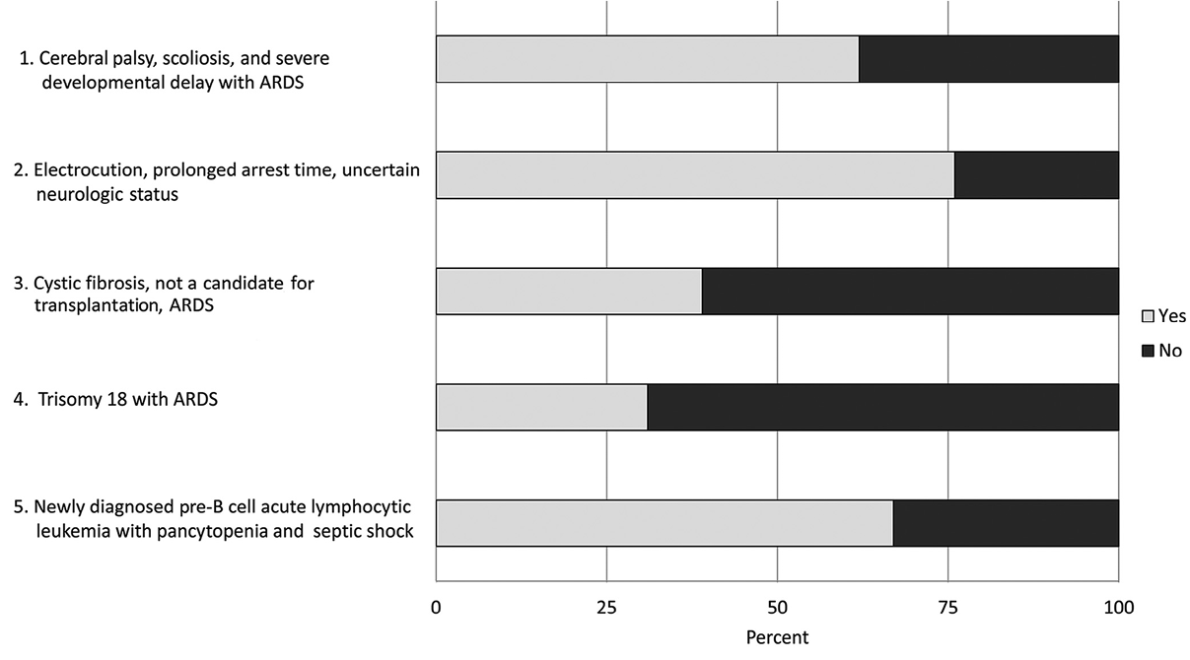
Defining High-Risk Populations
  Patients with high anticipated mortality with conventional therapies
  Patients who would be more likely to receive benefit than harm from ECMO
  Patients with a reversible/and or transplantable pathology
Trauma
Trisomy 13/18
Oncologic
J Pediatr: Should Extracorporeal Membrane Oxygenation Be Offered? An International Survey
(Kuo [2015])

Slide 6
Our Questions
From 2016 – 2024 (excluding 2020) in patients with “high-risk” (Trisomy 13/18, Trauma, Oncologic/Hematopoietic Stem Cell Transplant [HSCT]) diagnoses:
1. have there been changes in rates of ECMO utilization?
2. are there patient and/or hospital level factors that are associated with differences in ECMO utilization?

Slide 7
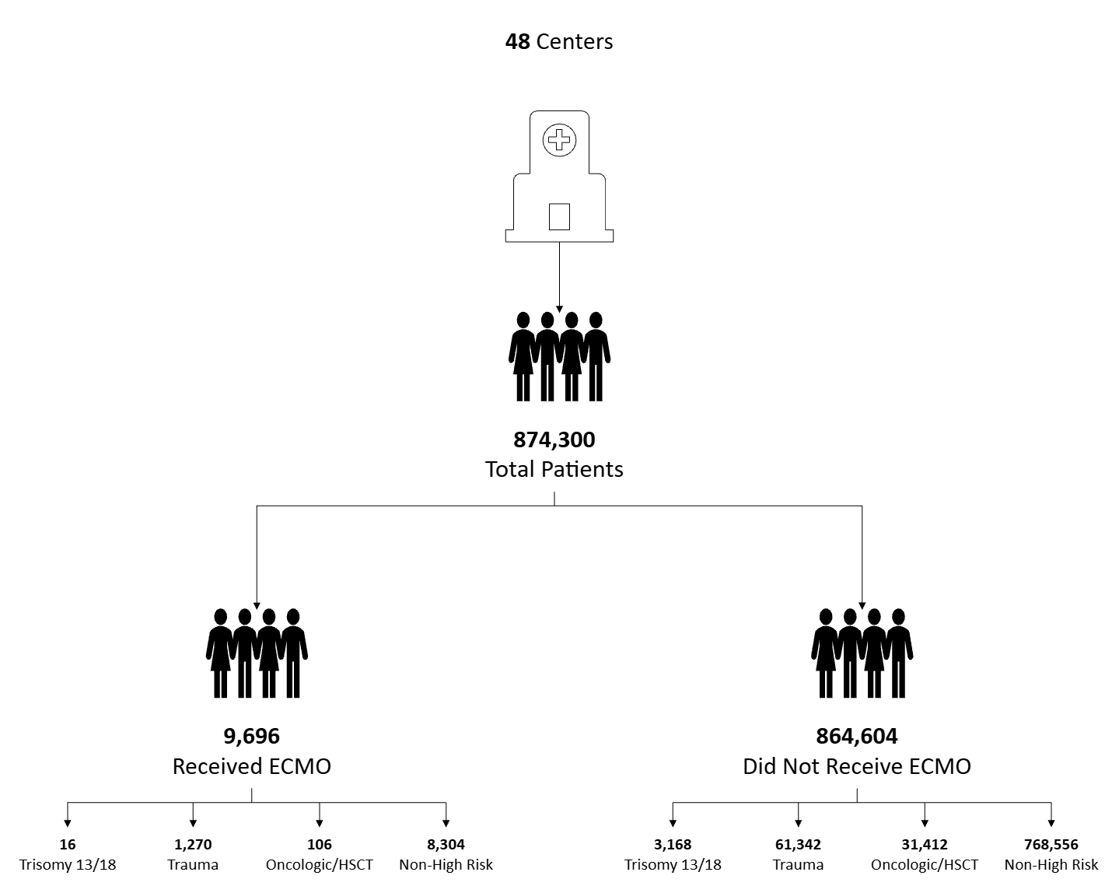
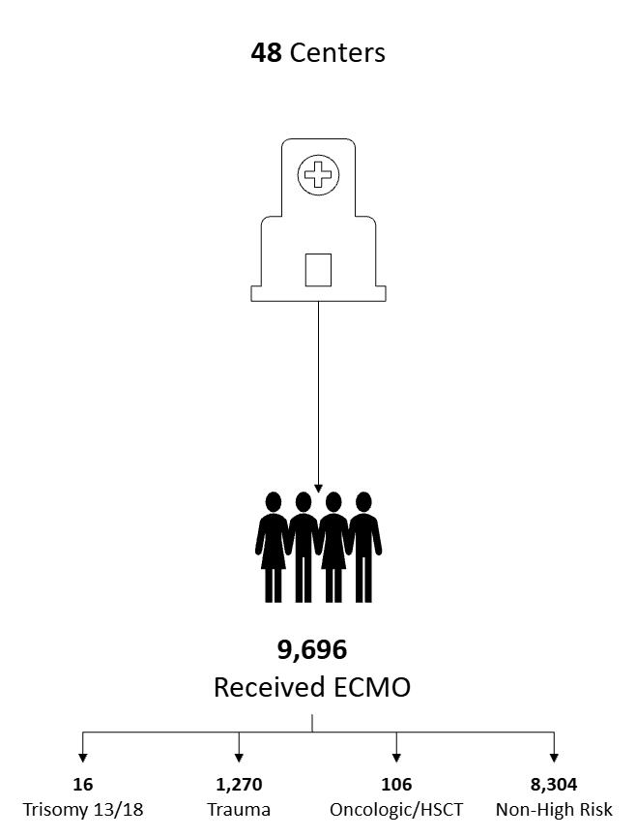
Category | n = 874,300 (%) | ECMO n =9,696 (%) | No-ECMO n = 864,604 (%) | p-value
Age (years), mean [SD] | 874,300 | 4.8 [7.7] | 7.1 [7.3] | < 0.001
Ethnicity | 874,300 |  |  | < 0.001
Hispanic/Latino | 188,349 (21.5) | 1,828 (20.9) | 186,521 (21.3)
Non-Hispanic | 641,896 (73.4) | 7,077 (80.9) | 634,819 (72.6)
Missing | 44,055 (5.0) | 791 (<0.1) | 43,264 (4.9)
High Risk Group | 874,300 |  |  | < 0.001
Not High-Risk | 776,860 (88.9) | 8,304 (85.6) | 768,556 (88.9)
Trisomy 13/18 | 3,310 (0.4) | 16 (0.2) | 3,294 (0.4)
Trauma | 62,612 (7.1) | 1,270 (13.1) | 61,342 (7.1)
Oncologic/BMT | 31,518 (3.6) | 106 (1.1) | 31,412 (3.6)
Mortality (%) | 874,300 | 22,979 (38.8) | 851,321 (2.2) | < 0.001
Category | n = 48 | Median (IQR)
Center Total Admissions | 48 | 22,121 (15,439 , 29,756)
Center Total ECMO | 48 | 250 (150 , 390)
Notes:
+---------------------------------------------------------------------------+
| Factor Level mortality = 0 mortality = 1 p-value |
|---------------------------------------------------------------------------|
| N 6586 4199 |
|---------------------------------------------------------------------------|
| high_risk_group T13/18 11 (0.2%) 9 (0.2%) <0.001 |
| Trauma 928 (14.1%) 484 (11.5%) |
| Onc/HSCT 58 (0.9%) 59 (1.4%) |
| Not High Risk 5589 (84.9%) 3647 (86.9%) |
+---------------------------------------------------------------------------+

Slide 8
What are the trends in ECMO utilization?
ECMO Cases by Year Adjusted for Admissions
 | Coefficient (95% CI) | p-value
Year of Service | -15.6 (-60.6 – 29.4) | 0.41
Annual Admissions (per 1,000) | 28.7 (10.3 – 47.2) | 0.01
Unpublished Data
Notes:
Average Number of ECMO cases: = 1,198 (95% CI: 1,064 ; 1,332)
Average Number of Admissions: = 106,900 (95% CI: 99,365 ; 114,435)
Reg annual_Admissions by YearOfService (CoE = 2016 p = 0.114)
Reg annual_ECMO by YearOfService (CoE = 42 p = 0.050)

Slide 9
Has ECMO receipt changed for trauma patients?
ECMO Cases by Year Adjusted for Admissions
 | Coefficient (95% CI) | p-value
Year of Service | -0.1 (-6.4 – 6.2) | 0.96
Annual Admissions (per 100) | 7.0 (0.7 – 13.4) | 0.04
Unpublished Data
Notes:
Average Number of ECMO cases: = 157 (95% CI: 138 ; 176)
Average Number of Admissions: = 7832 (95% CI: 7612 ; 8053)
Reg annual_Admissions by YearOfService (CoE = 34 p = 0.39)
Reg annual_ECMO by YearOfService (CoE = -0.233 p = 0.95)

Slide 10
Has ECMO receipt changed for everyone else?
ECMO Cases by Year Adjusted for Admissions
 | Coefficient (95% CI) | p-value
Year of Service | -7.2 (-57.6 – 43.3) | 0.73
Annual Admissions (per 1,000) | 24.5 (3.2 – 45.8) | 0.03
Unpublished Data
Notes:
Total Number of ECMO cases: = 1,026 (95% CI: 903 ; 1,149)
Total Number of Admissions: = 95,177 (95% CI: 87,700 ; 102,654)
Reg annual_Admissions by YearOfService (CoE = 2015 p = 0.114)
Reg annual_ECMO by YearOfService (CoE = 42 p = 0.030)

Slide 11
Has ECMO receipt changed for trisomy patients?
ECMO Cases by Year Adjusted for Admissions
 | Coefficient (95% CI) | p-value
Year of Service | -0.2 (-1.5 – 1.0) | 0.64
Annual Admissions (per 50) | 0.6 (-1.5 – 2.6) | 0.50
Unpublished Data
Notes:
Average Number of ECMO cases: = 2 (95% CI: 1 ; 3)
Average Number of Admissions: = 413 (95% CI: 336 ; 491)
Reg annual_Admissions by YearOfService (CoE = 33 p = 0.001)
Reg annual_ECMO by YearOfService (CoE = 0.08 p = 0.71)
9 total centers offered ECMO to patients

Slide 12
Has ECMO receipt changed for oncologic/HSCT patients?
ECMO Cases by Year Adjusted for Admissions
 | Coefficient (95% CI) | p-value
Year of Service | 0.7 (-0.7 – 2.1) | 0.21
Annual Admissions (per 100) | -0.5 (-4.6 – 3.6) | 0.77
Unpublished Data
Notes:
Average Number of ECMO cases: = 13 (95% CI: 10 ; 16)
Average Number of Admissions: = 3,940 (95% CI: 3,840 ; 4,039)
Reg annual_Admissions by YearOfService (CoE = 3.1 p = 0.87)
Reg annual_ECMO by YearOfService (CoE = 0.72 p = 0.17)
36 centers offered ECMO to onc patients

Slide 13
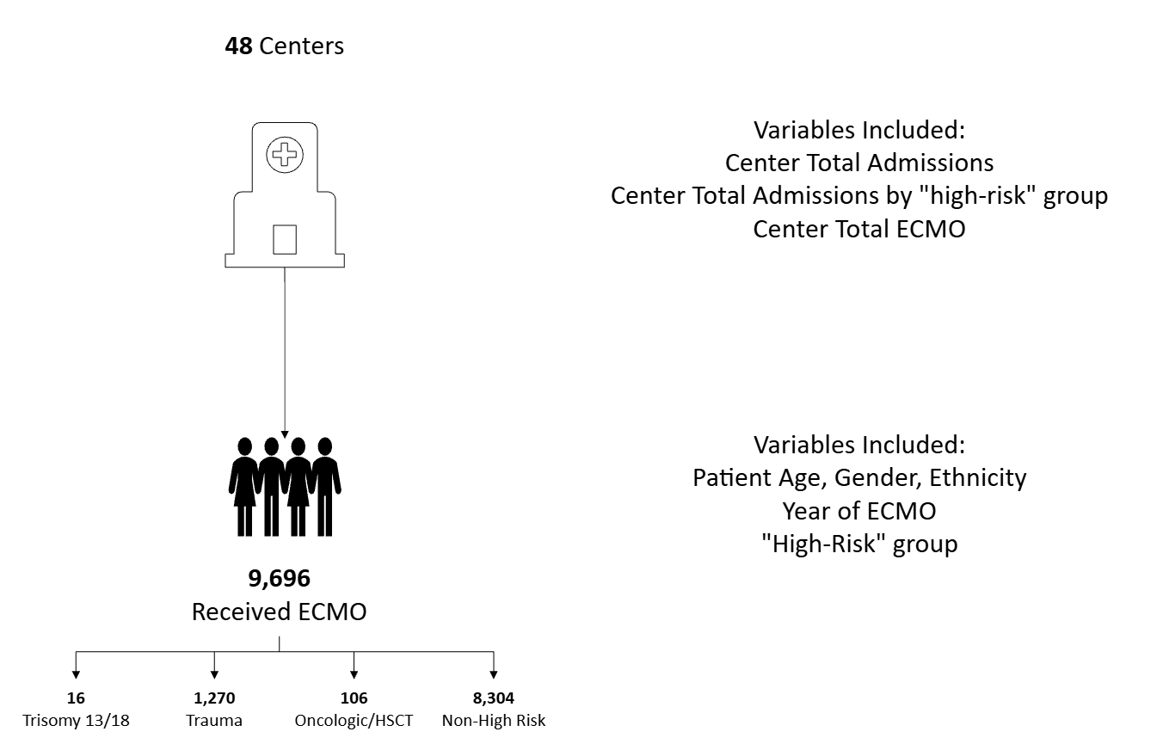
Making the model

Slide 14
Patient level factors that influence ECMO Utilization
Variable | Probability % (95% CI) | p-value
High-Risk Group
Trisomy 13/18 | 0.31 (0.19 – 0.50) | 0.001
Trauma | 1.51 (1.42 – 1.60) | <0.001
Oncologic/HSCT | 0.25 (0.20 – 0.30) | <0.001
Baseline | 0.70 (0.57 – 0.86) | <0.001
Other Patient Level Factors Included: Ethnicity, Gender, Patient Age, Year of ECMO
Unpublished Data
Notes:
ECMO Utilization as proportion:
Trisomy 13/18: 0.185%
Trauma: 13%
Onc/HSCT: 1%
Total: 1.12% of all admissions

Slide 15
Effect of Hospital Level ECMO on ECMO Utilization
ECMO Cases (2016 - 2024) | Probability % (95% CI) | p-value
200 | 0.8 (0.8 – 0.9) | <0.001
400 | 2.5 (2.1 – 2.9) | <0.001
600 | 7.0 (4.9 – 9.2) | <0.001
800 | 17.9 (10.1 – 25.0) | <0.001
1,000 | 37.7 (23.6 – 51.8) | <0.001
Interpretation: For every 200 ECMO Cases, the relative increase in probability of ECMO is ~250%
Unpublished Data
Notes:
Center Median ECMO (IQR): 250 (150 , 390)
99% : 530 cases / 8 years
1%: 12/ 8 years years

Slide 16
Effect of PICU Admissions on ECMO Utilization
PICU Admissions (2016 - 2024) | Probability % (95% CI) | p-value
10,000 | 2.8 (1.6 – 4.1) | 0.001
15,000 | 2.2 (1.4 – 2.9) | 0.001
20,000 | 1.7 (1.2 – 2.1) | <0.001
25,000 | 1.3 (1.1 – 1.5) | <0.001
30,000 | 1.0 (0.8 – 1.1) | <0.001
Interpretation: For every 5,000 patient admissions, the relative decrease in probability of ECMO is ~20%
Unpublished Data
Notes:
Center Median Admissions (IQR): 22,121 (15,439 , 29,756)
99%: Total Admissions = 54,479/ Total ECMO = ***/ proportion = ***%
1%: Total Admissions = 6,364/ Total ECMO = ***/ proportion = ***%

Slide 17
Acknowledgements
Ryan Barbaro MD, MSc
Erin Carlton MD, MSc
Stephen Gorga MD, MSc
Zubin Modi MD, MSc
Acham Gebremariam MS
Sarah Reeves PhD, MPH
Kao-Ping Chua MD, PhD
Susan B Meister & The Meister Foundation
Notes:
Data in our work likely pulls from the same pool of patients previously published
Given this it is possible that using administrative datasets such as PHIS may allow researchers to combine patient level and hospital level factors in hypothesis answering work regarding patient selection and outcomes on ECMO
ECMO utilization in high-risk populations has not changed significantly over time, limitation is that COVID did influence this and over coming years may find that there is a trend towards significance
Trauma patients likely do not need to be thought of any differently from a mortality risk standpoint for ECMO. T13/18 and Onc populations may present unique areas of thought when considering for candidacy. Hospital level factors may influence candidacy. Further evaluation tying candidacy/patient selection to outcomes may help elucidate how patient selection influences patient level outcomes

Slide 18
Questions
From a clinical perspective how do you think about the saliency of a differential risk of ECMO?
Recognizing the limitations of administrative datasets do you think that this work could be strengthened by controlling for ECMO candidacy/severity of illness?

Slide 19
References
Slide 3: Maratta C, Potera RM, van Leeuwen G, Castillo Moya A, Raman L, Annich GM. Extracorporeal Life Support Organization (ELSO): 2020 Pediatric Respiratory ELSO Guideline. ASAIO J. 2020;66(9):975-979. doi:10.1097/MAT.0000000000001223
Slide 4: MacLaren G, Conrad S,Peek G. Extracorporeal Life Support Organization (ELSO): 2015 Indications for Pediatric Respiratory Extracorporeal Life Support
Maratta C, Potera RM, van Leeuwen G, Castillo Moya A, Raman L, Annich GM. Extracorporeal Life Support Organization (ELSO): 2020 Pediatric Respiratory ELSO Guideline. ASAIO J. 2020;66(9):975-979. doi:10.1097/MAT.0000000000001223
Slides 5: Kuo KW, Barbaro RP, Gadepalli SK, Davis MM, Bartlett RH, Odetola FO. Should Extracorporeal Membrane Oxygenation Be Offered? An International Survey. J Pediatr. 2017;182:107-113. doi:10.1016/j.jpeds.2016.12.025

